Slide 1
Introduction to Data Science

Slide 2
Definition: high scale
Data science is an interdisciplinary field that uses scientific methods, processes, algorithms and systems to extract knowledge and insights from many structural and unstructured data. Data science is related to data mining, deep learning and big data *.
More concise definition: data science is the technology of handling and
extracting value from data
*Source: https://en.wikipedia.org/wiki/Data_science

Slide 3

History of Data Science
The term was first used in 1960 by Peter Naur, who was a pioneer in computer science.
He described the foundational aspects of the techniques and approaches used in data science in his 1974 book, Concise Survey of Computer Methods.
In 1996, the International Federation of Classification Societies used the term data science in its conference. A computer scientist named William S. Cleveland introduced data science as a discipline in his article, "Data Science: An Action Plan for Expanding the Technical Areas of Statistics," which was published in 2001 in the International Statistical Review. Over the years, it morphed and grew into the most sought-after, rapid-paced research technique of modern technology.

Slide 4
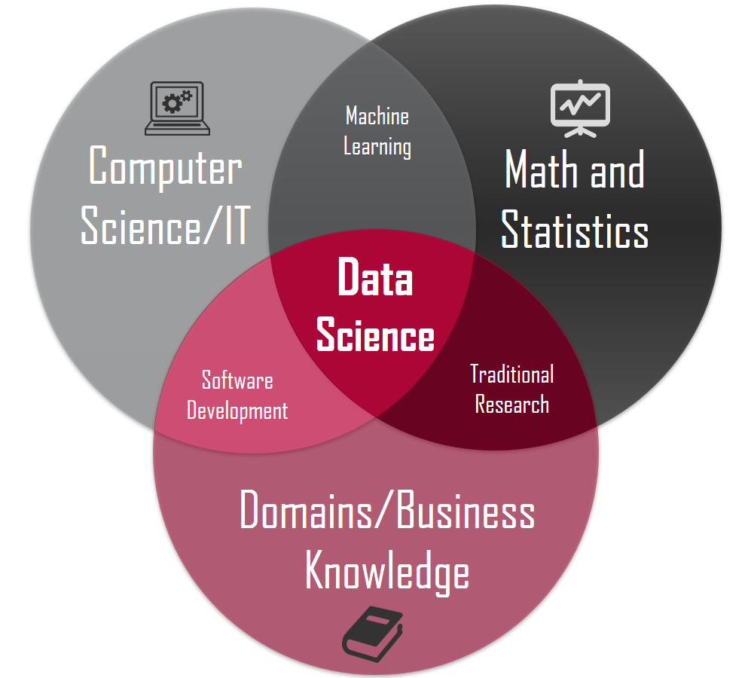
What is data science? (closer look)
Data science is scientific approach for
problem solving using large amount of data,
Computer scientific techniques using specific
Domain knowledge
Example: Using knowledge about bikers traffic,
Computer programming skills, statistical skills to
design an online bike sharing app.

Slide 5
Interests
Why is data science important?
Data science is a highly interdisciplinary practice involving a large scope of information and one that usually takes into account the big picture more than other analytical fields. In business, the goal of data science is to provide intelligence about consumers and campaigns and help companies create strong plans to engage their audience and sell their products.
Data scientists must rely on creative insights using big data, the large amounts of information collected through various collection processes, like data mining.

Slide 6
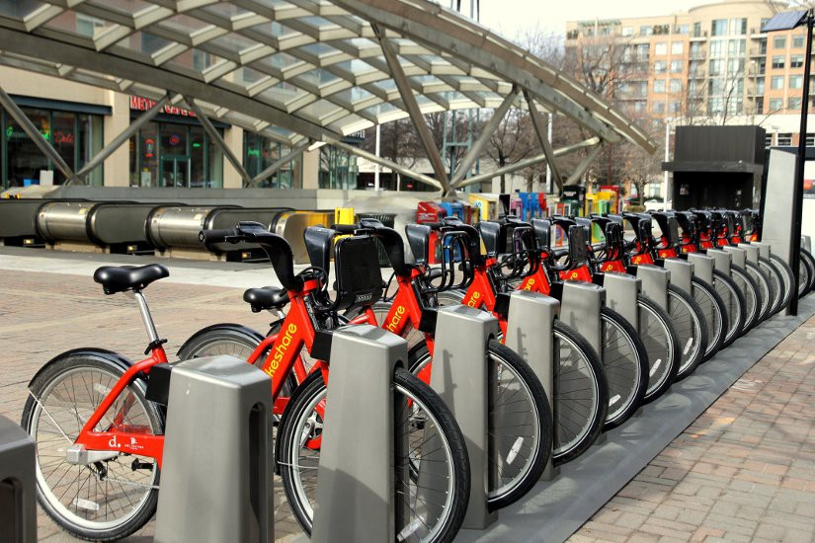
Example: Bike sharing system
Such systems usually aim to reduce congestion, noise, and air pollution by providing free/affordable access to bicycles for short-distance trips in an urban area as opposed to motorized vehicles.
The number of users on any given day can vary greatly for such systems.
The ability to predict the number of hourly users can allow the entities (businesses/governments) that oversee these systems to manage them in a more efficient and cost-effective manner.
The goal is to use and optimize Machine Learning models that effectively predict the number of ride-sharing bikes that will be used in any given 1 hour time-period, using available information about that time/day.

Slide 7
Skills
Data analysis: store and collect data about bikers’ trip patterns, peak bike usage, capacity planning, average trip duration
Statistics : Using collecteted data to draw statistical models and patterns, modeling bike usage time series
Computer programming: Programming the statistical models with capability of handling large scale data and handling concurrency, deploy machine learning models in scale
Machine learning: Using machine learning to train and deploy models for decision making about how many bikes the system should purchase, how to distribute bikes between stations

Slide 8
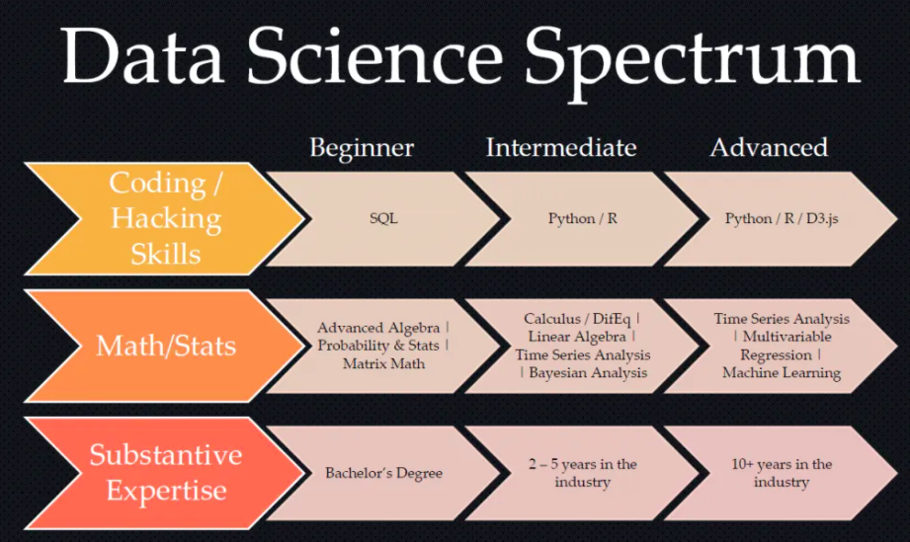
Data science skills spectrum
Data scientists have a range of skills:

Slide 9
Education path
Get an advanced degree (master, PhD) in a science or engineering field
Alway get engaged in interesting data modelling project
Look for hackathons and data-thons to attend
Download public data and practice with it:
https://www.data.gov/
https://archive.ics.uci.edu/ml/index.php

Slide 10
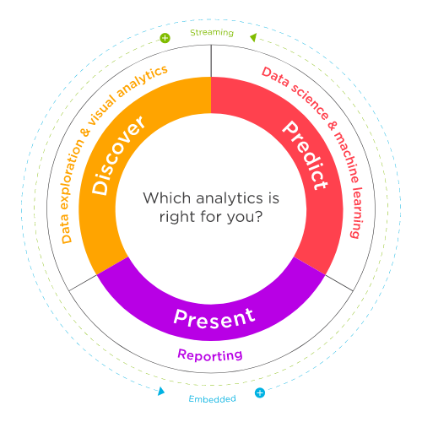
Different related careers:
Machine learning engineer
Machine learning scientist
Data Scientist
Data analyst
Quantitative analytics specialist (QA)
Federal government
Pharmaceuticals
Banking
Engineering
Technology
Marketing

Slide 11
Industries that rely on data science
public policy
risk management
robotics
machine translation
manufacturing
medical informatics
social science
speech recognition
travel
agriculture
big data
Digital economy
economics
fraud detection
healthcare
human resources
IT
marketing optimization

Slide 12

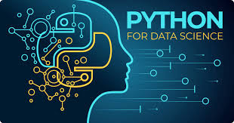




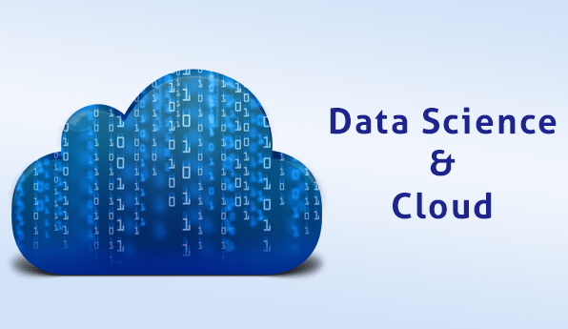
Tools
Microsoft Excel
Python
Spark
SQL
Tableau
R
Cloud data management tools

Slide 13


